Slide 1

DriverPass System Analysis
Jesse Jesseman
Notes:
[No speaker notes required for this slide.]

Slide 2

System Requirements
Functional requirements:
• Validation of user credentials during login.
• Provision of available appointments for the user to schedule.
Non-functional requirements:
• Web-based system, preferably on the cloud.
• Owner's accessibility to data from any computer or mobile device.
Notes:
Our system is designed to meet the needs of DriverPass by providing the following functionalities:
1. Validation of user credentials during login: Our system ensures that the username and password entered by the user match what is stored in our database. This allows each user to have their own login information and role.
2. Provision of available appointments for scheduling: Our system pulls an up-to-date calendar to provide customers and secretaries with available time slots to schedule appointments. This prevents overlapping appointments and ensures efficient scheduling.
3. Web-based system preferably on the cloud: Our system is designed to be run off the web, preferably on the cloud. This meets DriverPass’ needs, as this type of system allows for less overhead and provides greater accessibility.
By incorporating these functionalities, our system is tailored to meet the specific needs of DriverPass and help streamline their business processes.

Slide 3
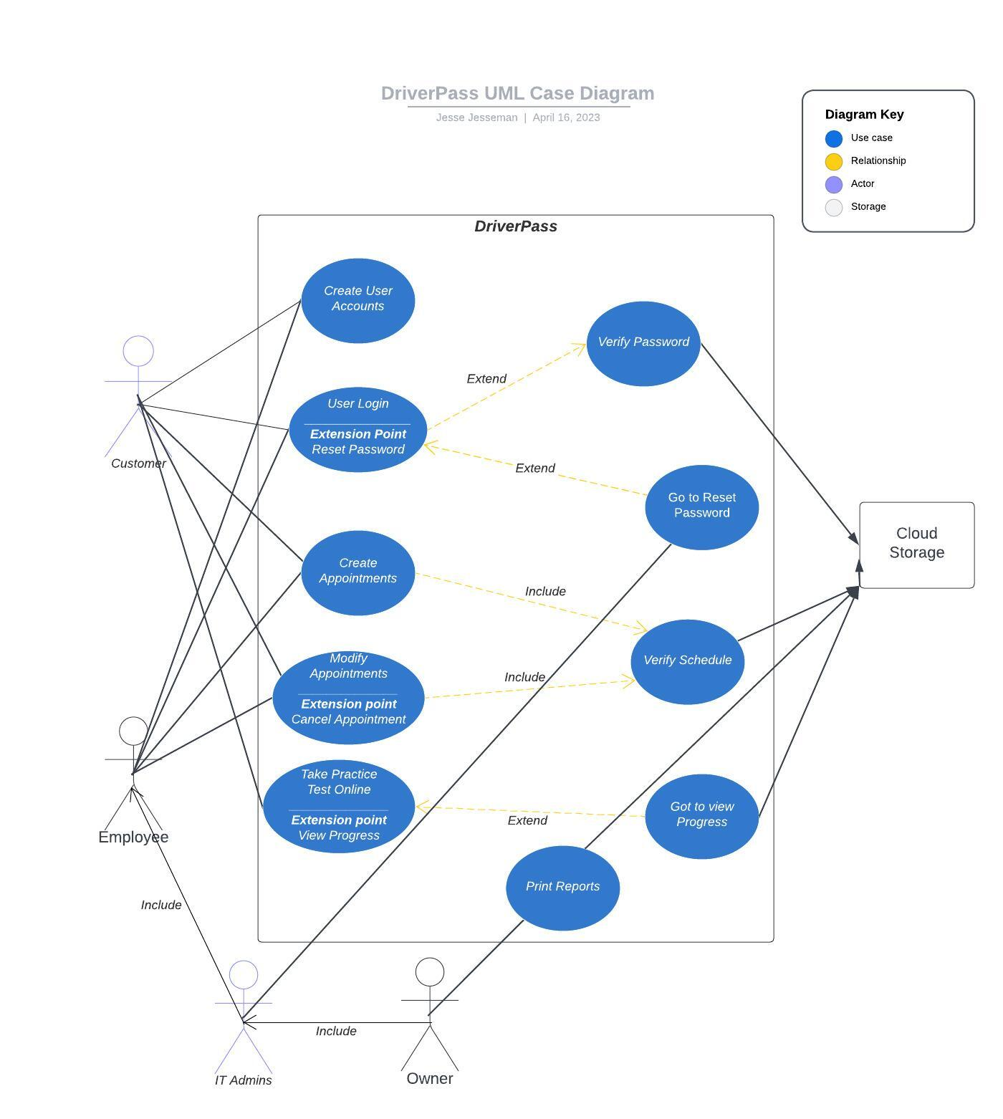
Use Case Diagram
Notes:
In this system, there are several different types of users: the customer, the employees, the IT officer, and the owner. Each user has different actions they can perform within the system. These actions include resetting passwords, updating customer information, scheduling appointments, viewing training progress, viewing training packages, and downloading data.
DriverPass' needs are taken into account in this system. For example, users can reset their password automatically, which is a requirement for DriverPass. The IT officer also has access to reset passwords when needed. The secretary has the ability to update customer information if necessary and can schedule appointments for customers who request it. Customers also have the ability to view their own training progress and available training packages.
Finally, the owner has the ability to download the data they need, which allows them to view it on the go. This feature was added to meet DriverPass' needs and provides convenience for the owner.

Slide 4
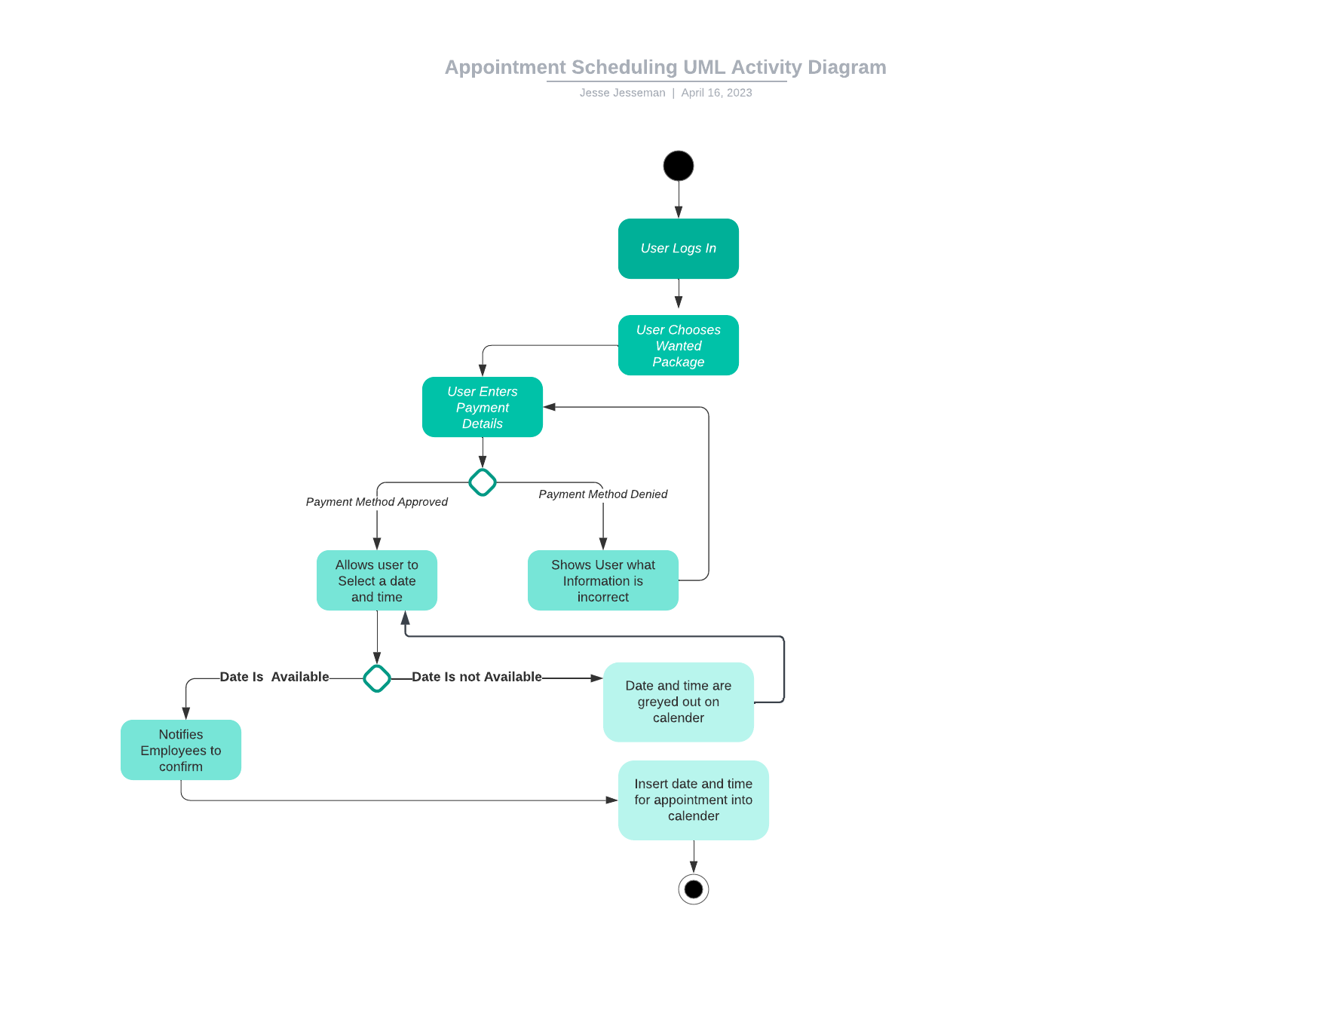
Activity Diagram
Notes:
In this activity diagram, we break down the appointment scheduling side of the DriverPass program. To start the user will log in and choose the package that is desired. Next, the system will prompt the user for a valid payment method. If I valid payment method is entered then the system will allow the user to select a date and time that works for them. If the payment method is not valid the system will highlight the incorrect information and allow the user to resubmit.
Next, If the date is available then the system will notify the correct employees and confirm the appointment while adding it to the company’s calendar. If the date selected is not available then the system will grey out the selected time and ask the user to choose a different date and time.
This meets the clients needs as it allows the users to schedule and pay for appointments without the need of any employee’s direct input.

Slide 5
Security
Users will need a username and password to log into the system.
Connection to the server would be encrypted to allow proper data security.
Users will be locked out of their account after 3 failed login attempts.
If users forget password, they will be able to reset it without the need of and IT admin.
IT admins can also reset passwords along with the owner.
Notes:
Ensuring the security of the DriverPass system is of utmost importance, and has been given significant consideration in the design. To provide secure access, the system requires a valid username and password for users to log in, which is the fundamental aspect of securing any application. However, beyond this, there are additional measures in place to maintain the confidentiality and integrity of user data.
To prevent unauthorized access, the system has an automatic lockout feature that is triggered after a certain number of unsuccessful login attempts. This ensures that only the user is attempting to log in to their account and not someone else who is trying to gain access maliciously. Additionally, the system provides the option for users to reset their passwords automatically, which adds an extra layer of security and makes the login process more secure.
To protect the security of the connection between the user and the system, all communication is encrypted using industry-standard SSL protocols. This helps prevent any unauthorized access to sensitive data while it is being transmitted between the user and the system.
In addition to these measures, the system is regularly monitored for any suspicious activity, and necessary security updates are implemented promptly. The IT officer also has the capability to reset passwords and perform other necessary security-related tasks to maintain the system's security.
Overall, the DriverPass system's security measures are robust and provide a secure platform for its users to access their accounts and data without any concerns about the security of their personal information.

Slide 6
System Limitations
Due to the small size, budget, and resources will be limited.
Very short three-month timeframe to completion.
Technology-based limitations as this application is web-based and no mobile applications were discussed
Users can not pick specific drivers.
Users can not retrieve their username.
Notes:
While our design for DriverPass has many strengths, there are some limitations to consider. As a small consulting company, we may have limited resources to devote to the project. Additionally, the three-month timeframe for the project may be challenging to meet, especially considering any unforeseen setbacks or complications that may arise.
Another limitation is that our system was designed primarily for use on desktop or laptop computers, and a mobile or cell-phone version of the system may not be immediately available. This may impact the convenience and accessibility of the system for users who prefer to access it on-the-go.
It's also important to note that our design does not currently allow users to select the driver they would like to work with for their on-road training. This may limit the level of customization or personalization that users have in their training experience.
Lastly, our system does not currently have a feature for users to retrieve their username if they forget it. While users can reset their password, forgetting their username could still pose an issue and require additional support from our team.

